Slide 1

NYC Building Data Visualizer
Mapping and analyzing trends in NYC real estate
Artjoms Zuks

Slide 2
Problem Statement
Assist with getting construction and price information about neighborhood
How has the price of rent increased in the past
What are the projections for sales prices in the next 24 months
How much improvement has the area had over time
How much construction noise level will there be in the area

Slide 3
Data -NYC Open Data/Street Easy pricing data
NYC Open Data (CloudSearch for indexing)
Permits are filed when any walls are modified in most buildings
Includes everything from construction and demolition to people renovating their home
Data is json accessible with API key and has a query interface
Street Easy Data (SageMaker for analysis)
Median prices from last 8 years for rent and sales in csv
Data provided by neighborhood and broken up by month
https://opendata.cityofnewyork.us/

Slide 4
End Product
Web UI that exposes geo-search and faceting on Department of Buildings data
Faceting on
Time Ranges
Permit Types
Area
Analytics on construction over time
Expose interesting trends
Predict future construction developments
Forecasts for predicting future prices in neighborhood

Slide 5
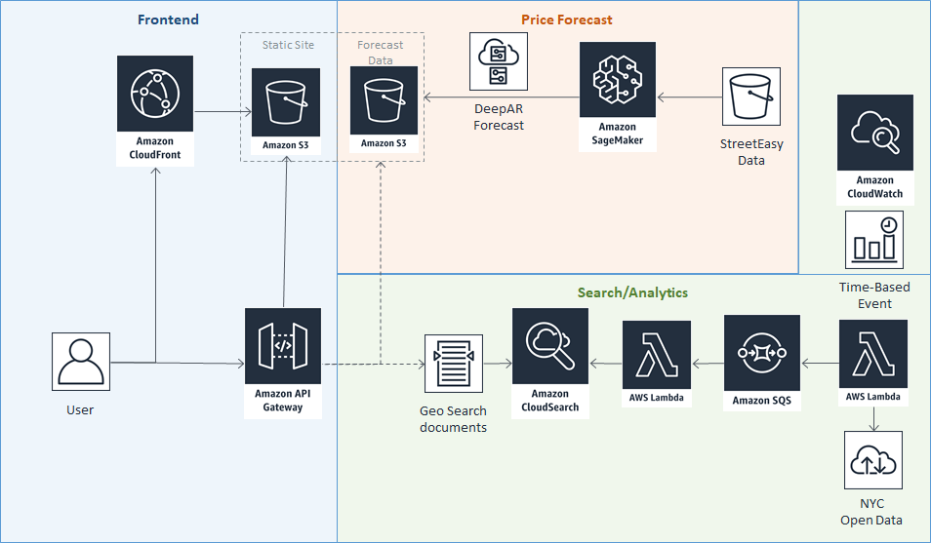
Design

Slide 6
Demo
CloudFront: http://d3r6xspzdsmgol.cloudfront.net Backup Direct S3 Link: http://buildingviz-site.s3-website-us-east-1.amazonaws.com https://www.youtube.com/watch?v=sSN1EyDSniQ

